Slide 1

KR Network Cloud Tech. Pvt. Ltd.
Swap Partition
The swap partition is the portion of the hard drive that linux uses as virtual memory when it runs out of physical memory.
It's similar to the windows swap file only instead of using an actual file, linux uses a partition on the hard drive instead.
Swap space in Linux is used when the amount of physical memory (RAM) is full. If the system needs more memory resources and the RAM is full, inactive pages in memory are moved to the swap space.
Swap should equal 2x physical RAM for up to 2 GB of physical RAM, and then an additional 1x physical RAM for any amount above 2 GB, but never less than 32 MB.

Slide 2
KR Network Cloud Tech. Pvt. Ltd.
Swap Size At least
2GB swap space for 4GB of RAM or less.
4GB swap space for 4-16GB of RAM
8GB swap space for 16-64GB of RAM
16GB swap space for 64-256GB of RAM
32GB swap space for 256-512GB of RAM
Create Swap partition
To accomplish this task you must be login form root
account. So first login from root and verify your hard disk.
And then create one partition with hexa code 82.

Slide 3
KR Network Cloud Tech. Pvt. Ltd.
Step 1 :
# fdisk -l
Suppose your hard disk name is /dev/sda
Step-2
# fdisk /dev/sda { to create partition }

Slide 4
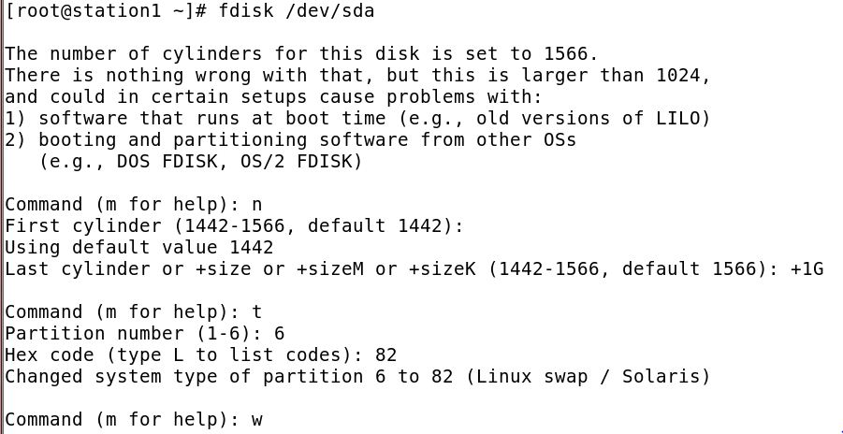
KR Network Cloud Tech. Pvt. Ltd.

Slide 5
KR Network Cloud Tech. Pvt. Ltd.
Step-3
# partprobe /dev/sda {In RHEL-5}
Or
#partx –a /dev/sda {In RHEL-6}
#partx –a /dev/sda
Note (Run this command two times.)
# mkswap /dev/sda { to create swap }
# swapon /dev/sda6 { to activate swap}
# swapon -s
{ to check all swap partions with status }

Slide 6
KR Network Cloud Tech. Pvt. Ltd.
To permanently mount this partition makes its entry in /etc/fstab as shown in image
#vim /etc/fstab
/dev/sda6 swap swap defaults 0 0
:wq (save & exit)
# mount -a
# free -m
#free -m -t
# cat /proc/meminfo

Slide 7
KR Network Cloud Tech. Pvt. Ltd.
How to remove swap partition
#swapoff /dev/sda6
#swapon -s
# vim /etc/fstab
Remove last swap entry. Use dd option.
:wq
# mount -a
# fdisk /dev/sda
:d
:6
:w
#partx -a /dev/sda

Slide 8
KR Network Cloud Tech. Pvt. Ltd.
Quota
Quota is used for limiting the disk usage for users or groups
Quotas are used to limit a users or a group of users ability to consume disk space
.
Group level quota can be applied to primary groups.
You have two ways to set quotas for users. You can limit users by inodes or by kilobyte-sized disk blocks. Every Linux file requires an inode. Therefore, you can limit users by the number of files or by absolute space.

Slide 9
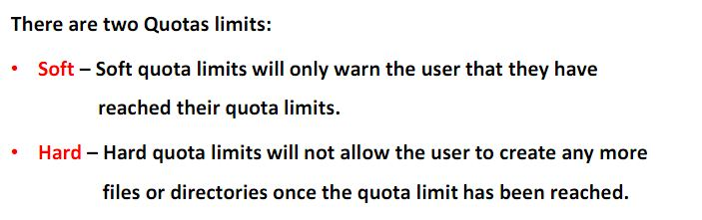
KR Network Cloud Tech. Pvt. Ltd.

Slide 10
KR Network Cloud Tech. Pvt. Ltd.
Grace Periods :-
Linux has provided the default of seven days for both inodes and block usage. That is, a user may exceed the soft limit on either resource for up to seven days. After that, further requests by that user to use files will be denied.

Slide 11
KR Network Cloud Tech. Pvt. Ltd.
Practical
###The quota package###
Step 1 :::
#rpm –qa quota*
Step 2 :::: (to add quota options )
# vim /etc/fstab
LABEL=/home /home ext4 defaults,usrquota,grpquota 1 1 :wq
Step 3 :::
#mount –a
#mount -o remount /home
(Check the filesystem is mounted with changed options)

Slide 12
KR Network Cloud Tech. Pvt. Ltd.
Step 4 ::::
###Create quota database####
#quotacheck -cugv /home
Where :
-c option create. -u to check for user quotas. -g to check for group quotas. -f forcefully
(Note)
quotacheck -cugv /home -will create following files in
cd /home aquota.group aquota.user

Slide 13
KR Network Cloud Tech. Pvt. Ltd.
Step 5 ::::
#quotaon /home {to activate quota}
#mount {to check}
step 6 ::
###Assign quota policies for user###
#edquota –u username
#quota -g sales ###Assign quota policies for group

Slide 14
KR Network Cloud Tech. Pvt. Ltd.
Step 7 ::::
To check quota limits for any user.
First switch in to the user account with su command and then use dd command to create a dump file with a particular limits
# su - Krishna
[Krishna @ server1 ~ ] $ pwd
$dd if=/dev/zero of=abc bs=1024 count=50
Here it will show warning .
$dd if=/dev/zero of=abc bs=1024 count=100

Slide 15
KR Network Cloud Tech. Pvt. Ltd.
Show warning and disk quota limits exceeded.
$ du –sh abc
$ rm abc
$ touch a{1,2,4,5,6,7,8,9}
For testing of file limits. Here it will show warning.
$ touch b{1,2,3,4,5,6,7,8,9,10}
Here it will show limits exceeded. And will not create file b8, b9 , b10.
$ quota
$exit

Slide 16
KR Network Cloud Tech. Pvt. Ltd.
Important commands for quota limits monitoring ::::
#quota username -shows the quota for set for that user or
#quota -u Krishna
###
$ quota
$exit

Slide 17
KR Network Cloud Tech. Pvt. Ltd.
Important commands for quota limits monitoring ::::
#quota username -shows the quota for set for that user or
#quota -u Krishna
#quota -g sales
###Assign quota policies for group###
#edquota -g groupname -think a user should exist with that group. #quota -g groupname -shows the quota for set for that group ###Defining prototypical users### # edquota -p user1 user2 ###To see all user qoutas### #repquota -a ###To see the user quotas in /home### #repquota -u /home

Slide 18
KR Network Cloud Tech. Pvt. Ltd.
###To see the group quotas in /home### #repquota -g /home
###To see the quotas in appropriate size### #repquota -s /home -shows used space and hard limit in MB ###To check the quota is on or not###
#quotaon -v /home ###Setting grace period### #edquota -t 10days not 10 days.

Slide 19
KR Network Cloud Tech. Pvt. Ltd.
For particular user set grace period:-
#edquota –T krishna ###To enable and disable the qoutas###
# vim /etc/fstab
Remove both usrquota,grpquota words in front of /home.
Then :wq!
#mount -a #quotaoff -vaug /home -will turn off all the quotas [gruop and user]
#mount -o remount /home
# mount {to check quota is enable or not}

